Slide 1
Web design Technology
Name Camira chissico

Slide 2
Startup Name
Name1, Name2, …
DD/MM/YYYY
X.Y
Simplifies the process of discovering and enjoying gourmet cuisine.
Enhances everyday meals with elegant, high-quality recipes or dishes.
Provides a premium, convenient dining or recipe experience at home.
Saves time for busy professionals and food lovers.
Inspires creativity and joy in cooking and eating.
Curated collection of gourmet recipes or meal kits.
Professional-quality photos, videos, and cooking instructions.
Subscription or on-demand delivery options for prepared meals or ingredients.
Customizable meal planning.
Mobile-friendly user experience.
Support for dietary needs (vegan, gluten-free, etc.).
Integrated reviews and community feedback.
.
To impress guests or family with high-quality meals.
To explore fine dining or global cuisine easily.
To feel confident and creative in the kitchen.
To have an elevated food experience at home
Wasting money on poor-quality food or recipes.
Feeling overwhelmed by complex cooking steps.
Not having enough time to prepare gourmet meals.
Risk of failure (burnt meals, disappointment).
Users feel pampered, inspired, and satisfied.
A sense of elegance and delight when exploring or cooking meals.
A unique emotional connection to fine dining from the comfort of home.
Premium yet accessible — elevates users' everyday culinary routines.
Reliable, easy-to-follow gourmet food content or services.
Convenient access to ingredients or meals.
Clear instructions and guidance.
Trust in the platform’s quality and expertise.
Traditional restaurants or takeout.
YouTube tutorials and food blogs.
Meal kit services like HelloFresh or Blue Apron.
Cookbooks and offline recipes.
SABRINAS RESTAURANT
YASSER

Slide 3
.
.
.
.
.
Startup Name
Name1, Name2, …
DD/MM/YYYY
X.Y
Busy people lack time to plan and cook high-quality meals.
Home chefs struggle to find reliable, elegant, gourmet recipes.
Fine dining is often inaccessible due to cost or location
Curated collection of premium, easy-to-follow gourmet recipes.
Option to order high-quality meal kits or ingredients.
Elegant, user-friendly digital experience with rich visuals and step-by-step guidance
Luxury dining made easy — La Belle Cuisine brings gourmet cooking into your home through elegant recipes, curated kits, and refined taste."
Busy professionals with high taste standards.
Home cooks who love exploring gourmet cuisine.
Event planners and hosts looking to impress guests.
Food bloggers, influencers, and culinary students
Brand identity rooted in French culinary elegance and exclusivity.
Proprietary recipe curation from top chefs.
Exceptional user interface and personalized recommendations.
Takeout from local restaurants.
Recipe blogs or YouTube videos.
Subscription meal kits (e.g., HelloFresh, Blue Apron).
Dining at restaurants.
Number of active users or subscribers.
Recipe page views and kit purchases.
Repeat purchase rate and customer retention.
Engagement on social media and newsletter.
Number of active users or subscribers.
Recipe page views and kit purchases.
Repeat purchase rate and customer retention.
Engagement on social media and newsletter.
)
Instagram and Pinterest (visual-driven content).
Food blogs and partnerships with influencers.
Google Ads and SEO targeting gourmet recipes.
Email newsletters and loyalty programs
Food lovers who frequently try new recipes or meal kits.
People who subscribe to food magazines or gourmet services.
Urban residents with disposable income and busy schedules.
Website development and hosting.
Content creation (recipes, videos, photography).
Marketing and advertising spend.
Ingredient sourcing and distribution (if kits offered).
Salaries for chefs, developers, and support staff.
Subscription for exclusive recipes or cooking classes.
Sales of gourmet meal kits or ingredients.
Affiliate commissions from featured kitchen products.
Sponsored content or brand partnerships.
Premium access/membership

Slide 4
Startup Name
Name1, Name2, …
DD/MM/YYYY
X.Y
Access to curated, high-quality meals.
Save time with ready-to-order gourmet food.
Elevate personal or professional events.
Stand out with unique, luxurious food options.
Confidence in food quality and hygiene.
Access to high-end gourmet meals.
Convenience in ordering luxury food online.
Discover new elegant recipes and culinary trends.
Host refined events with premium catering.
Aesthetic presentation and packaging.
Food may not meet luxury standards.
Late or poor-quality delivery.
Hygiene or freshness concerns.
Complicated or untrustworthy platforms.
High prices not matching expectations.
Smooth, luxurious website interface.
Visually appealing product and packaging.
Responsive support and live order tracking.
Personalized user recommendations.
Engaging content: cooking videos, blog posts.
Reliable gourmet food services.
Easy, user-friendly ordering experience.
Transparent pricing and quality assurance.
Trustworthy catering for important events.
Inspiration for home cooking with professional flair.
Gourmet meal delivery service.
Elegant, chef-approved recipes and tutorials.
Premium event catering options.
Giftable gourmet food packages.
Subscription-based culinary boxes
Uber Eats or Deliveroo (for convenience).
Local luxury restaurants or private chefs.
DIY gourmet cooking blogs or YouTube channels.
Generic catering companies without premium focus.
Urban professionals, food lovers, event hosts, or gift-givers who value quality, presentation, and convenience in gourmet food.
King Pie

Slide 5
Startup Name
Name1, Name2, …
DD/MM/YYYY
X.Y
Beautiful, user-centric website and mobile UX.
Recipes tailored to elegant, home-cooked dining.
Rewards/loyalty program and personalized meal picks.
Culinary content for education and entertainment.
Social sharing tools and customer showcase features.
Fast, reliable access to luxurious, gourmet food.
Confidence in elegant presentation and freshness.
Enjoyment of a seamless, aesthetic digital experience.
Personalized recommendations and premium content.
Hosting events with high-end, worry-free catering.
Gourmet food delivery (individual meals or packages).
Elegant catering services for personal and corporate events.
Curated gourmet recipe collections and cooking content.
Subscription boxes (e.g., chef’s tasting boxes).
Giftable luxury food hampers.
Order premium gourmet meals online.
Plan elegant catered events.
Discover new gourmet recipes or cooking ideas.
Gift luxury food packages.
Learn culinary techniques and stay inspired.
Difficulty finding consistent high-end food quality.
Long delivery times or poor logistics.
Complicated or untrustworthy food ordering platforms.
Frustration with impersonal catering services.
Limited culinary inspiration from other food sites.
Verified chefs and premium ingredient sourcing.
Intuitive platform with real-time order tracking.
Clear pricing and customizable options.
Professional staff for catered events.
Strict hygiene and freshness policies.
Delivering gourmet food experiences through elegant meals, recipes, and catering — combining convenience, sophistication, and culinary delight for the modern food lover.
Urban food lovers and professionals who seek convenience, luxury, and high-quality meals at home or at events.

Slide 6
Startup Name
Name1, Name2, …
DD/MM/YYYY
X.Y
What type of relationship does each of our Customer Segments expect us to establish and maintain with them? Which ones have we established? How are they integrated with the rest of our business model? How costly are they?
For whom are we creating value? Who are our most important customers? Is our customer base a Mass Market, Niche Market, Segmented, Diversified, Multi-sided Platform
Meal preparation and gourmet food packaging
Platform/app development and maintenance
Logistics coordination and delivery management
Content creation: recipes, cooking videos.
Local gourmet chefs and premium ingredient suppliers
Logistics/delivery service providers
Kitchen and catering equipment vendors
Food bloggers and culinary influencers
Event planners and corporate clients
Online payment gateways
Elegant, gourmet meals delivered conveniently
Personalized, premium catering for events
Curated gourmet recipe library
High-end user experience (online and offline)
Reliable, beautifully presented food service
Professional kitchen facilities
Culinary talent (chefs, food stylists)
E-commerce website and mobile app
High-quality media content
Brand and digital presence
Delivery infrastructure and tech integrations
Through which Channels do our Customer Segments want to be reached? How are we reaching them now? How are our Channels integrated? Which ones work best? Which ones are most cost-efficient? How are we integrating them with customer routines?
What are the most important costs inherent in our business model? Which Key Resources are most expensive? Which Key Activities are most expensive? IS YOUR BUSINESS MORE: Cost Driven (leanest cost structure, low price value proposition, maximum automation, extensive outsourcing), Value Driven (focused on value creation, premium value proposition). SAMPLE CHARACTERISTICS: Fixed Costs (salaries, rents, utilities), Variable costs, Economies of scale, Economies of scope
For what value are our customers really willing to pay? For what do they currently pay? How are they currently paying? How would they prefer to pay? How much does each Revenue Stream contribute to overall revenues? TYPES: Asset sale, Usage fee, Subscription Fees, Lending/Renting/Leasing, Licensing, Brokerage fees, Advertising FIXED PRICING: List Price, Product feature dependent, Customer segment dependent, Volume dependent DYNAMIC PRICING: Negotiation (bargaining), Yield Management, Real-time-Market

Slide 7
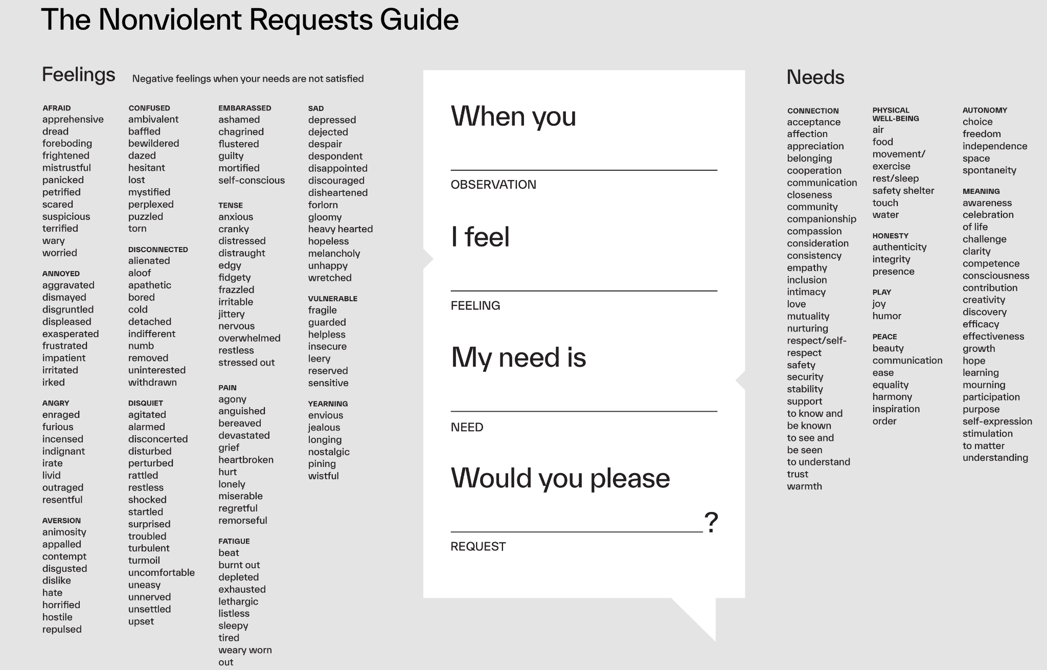

Slide 8
